Slide 1
Navigating Cross-Pressures: How Acculturation Shapes Latino Political Behavior
Jessala A. Grijalva
Postdoctoral Research Associate
University of Notre Dame 🍀, Institute for Latino Studies

Slide 2
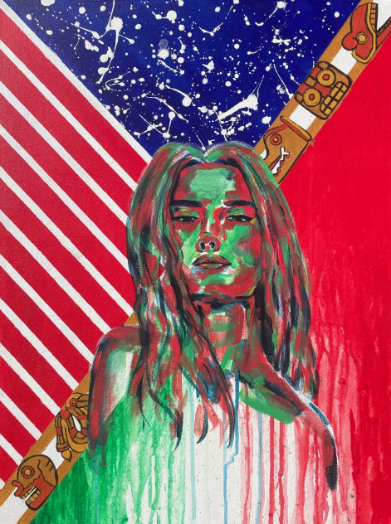
The new mestiza copes by developing a tolerance for contradictions, a tolerance for ambiguity... Not only does she sustain contradictions, she turns the ambivalence into something else.
- Gloria Anzaldúa, 1987, p. 79)
Cultural Hybridity as a Normative Latino Experience

Slide 3
Cultural Retention Assimilation
Binary Acculturation
Either/Or, but NOT both
Example from (Branton et al., 2014):
To examine the impact of acculturation on moral policy preferences we account for various facets of the acculturation experience including nativity, language skills, and time in the U.S. In accordance with the research above, we expect less acculturated Latinos to express more opposition to legalized abortion and less support for legal recognition of same- sex couples than more acculturated Latinos.

Slide 4
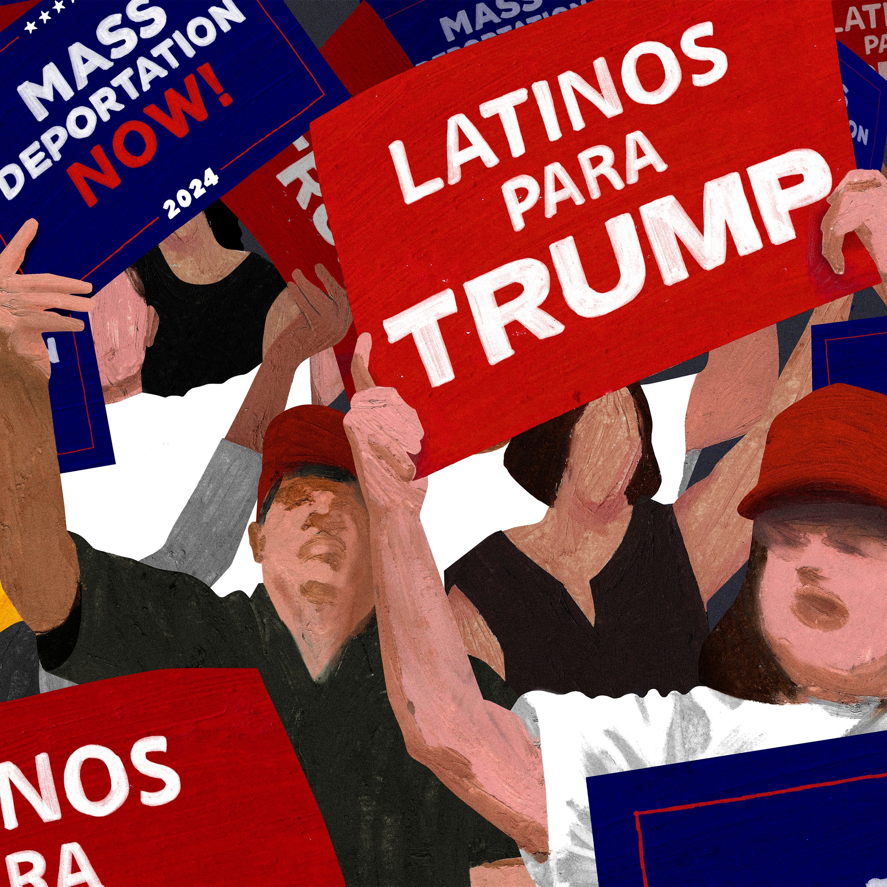
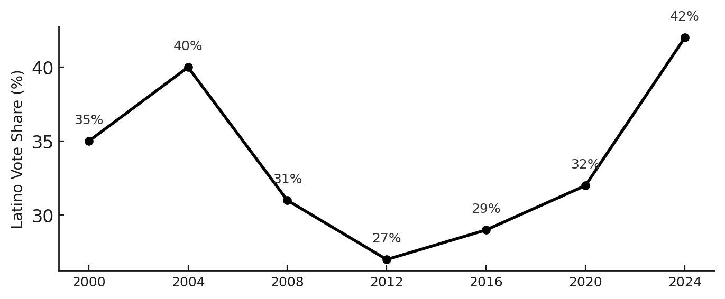
Research Gap

Slide 5
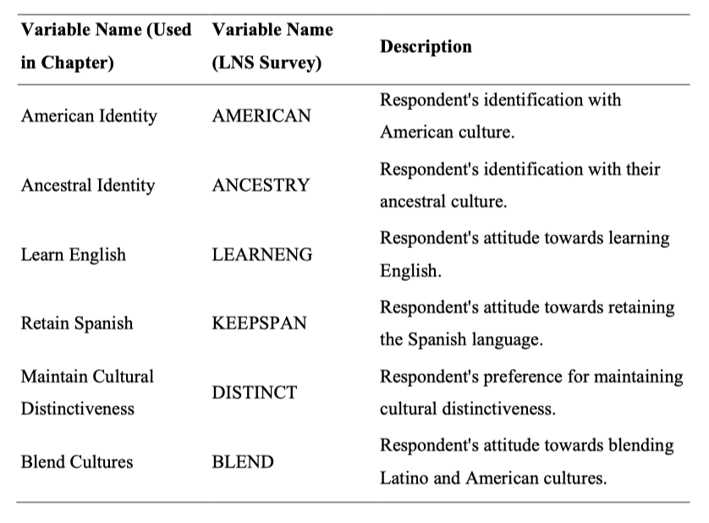
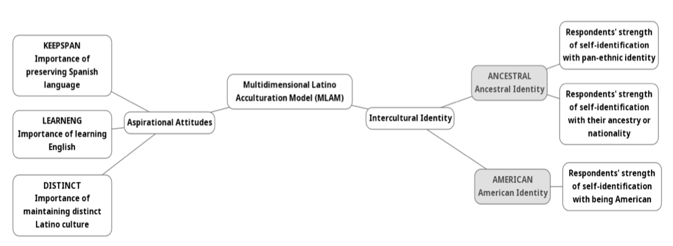
MLAM Operationalizing Data from 2006 Latino National Survey

Slide 6
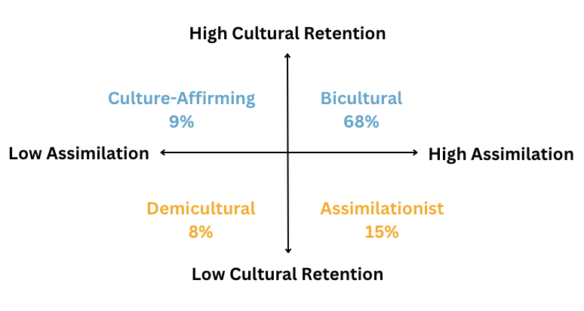
Multidimensional Latino Acculturation Model

Slide 7
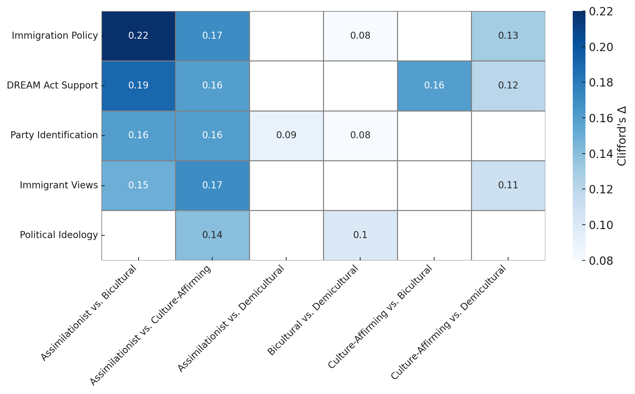
Cross-Pressures

Slide 8
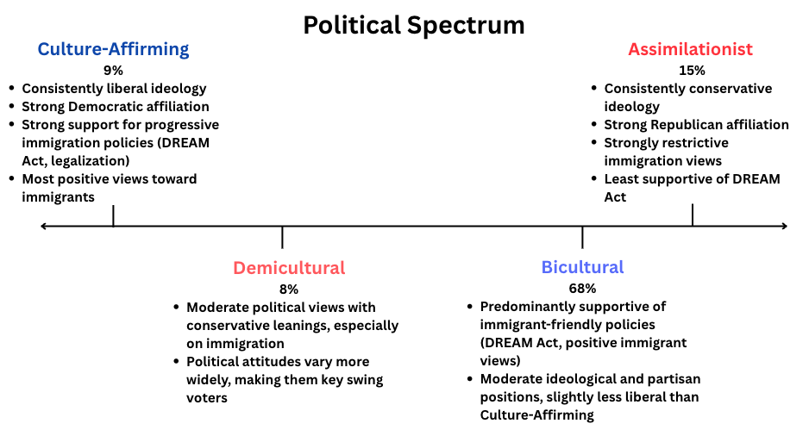
First Bidirectional Look – Political Profiles by Acculturation Orientation

Slide 9
Final Takeaways
Bidirectional Acculturation > Binary Acculturation
Cultural Hybridity, normative for a majority of Latinos
Acculturation taps into Latino liminality (social identity, strategies for navigating cultural differences, etc.)
MLAM better captures acculturation and explains Latino political behavior, critical for accurate political representation

Slide 10
Thank You!
- Jessala A. Grijalva

